Slide 1
Zero Downtime Proof Of Concept
Architecture and Principles

Slide 2
Goal
Proof for an Azure PaaS Deployment Architecture
Provide a foundational Architecture to form the basis of new greenfield deployment patterns for NBME’s Azure adoption
Primary Stakeholders:
Application Development team
& IT Operations

Slide 3
Principles
Showcase ease of Operations

Slide 4
Design
Scenario: Assuming a three tier application, changes to any of the tier should not cause downtime
Part - 1 | Deploy a multi-tier architecture in 1-region (East US).
Foundational | 1 | App Gateway and/or Traffic Manager
 | 2 | Front-end App Service
 | 3 | Middle-tier Azure Function (as a proxy to business logic)
 | 4 | Cosmos DB
Part-2 | 1 | Introduce a version change to Middle-tier and CosmosDB
 | 2 | Deploy & Monitor Zero downtime
Part-3 | 1 | Introduce a version change to Front-end
 | 2 | Deploy & Monitor Zero downtime

Slide 5
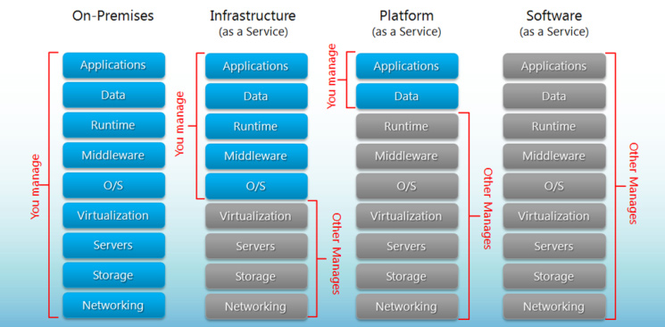
R & R

Slide 6











DEMO
SEQUENCE
Proposed
RG-NETWORKING
RG-OPERATIONS
A controller like
Traffic Manager / Application Gateway
STEP | EVENT
0 | Blank Azure Subscription
1 | Site admin DEPLOYS entire stack containing V1 Monitors traffic
OMS / Log Search
RG-V2
RG-V1
2 | Site Admin DEPLOYS v2 stack. No production traffic to v2 Monitors traffic.
verifies
FE
FE
3 | DevOps team VERIFIES V2 is working fine Monitors traffic
DevOps
App Insights
MID
TIER
MID
TIER
4 | Site admin and DevOps Puts v2 in rotation. Some live traffic to v2 Monitors traffic
5 | Site admin and DevOps Deprecates v1
RG-BACKEND
Azure Monitor
Notes:
At any time, only one of the environments is live, with the live environment serving all production traffic. For this example, Blue is currently live and Green is idle.

Slide 7

Single Region Zero Downtime
DEMO
SEQUENCE
Proposed
Traffic Manager
RG-NETWORKING
RG-OPERATIONS
Application Gateway
(use as a regional controller)
STEP | EVENT
0 | Blank Azure Subscription
1 | Site admin DEPLOYS entire stack containing V1 Monitors traffic
OMS / Log Search
RG-V2
RG-V1
2 | Site Admin DEPLOYS v2 stack. No production traffic to v2 Monitors traffic.
verifies
FE
FE
3 | DevOps team VERIFIES V2 is working fine Monitors traffic
DevOps
App Insights
MID
TIER
MID
TIER
4 | Site admin and DevOps Puts v2 in rotation. Some live traffic to v2 Monitors traffic
5 | Site admin and DevOps Deprecates v1
RG-BACKEND
Azure Monitor
Notes:
At any time, only one of the environments is live, with the live environment serving all production traffic. For this example, Blue is currently live and Green is idle.

Slide 8
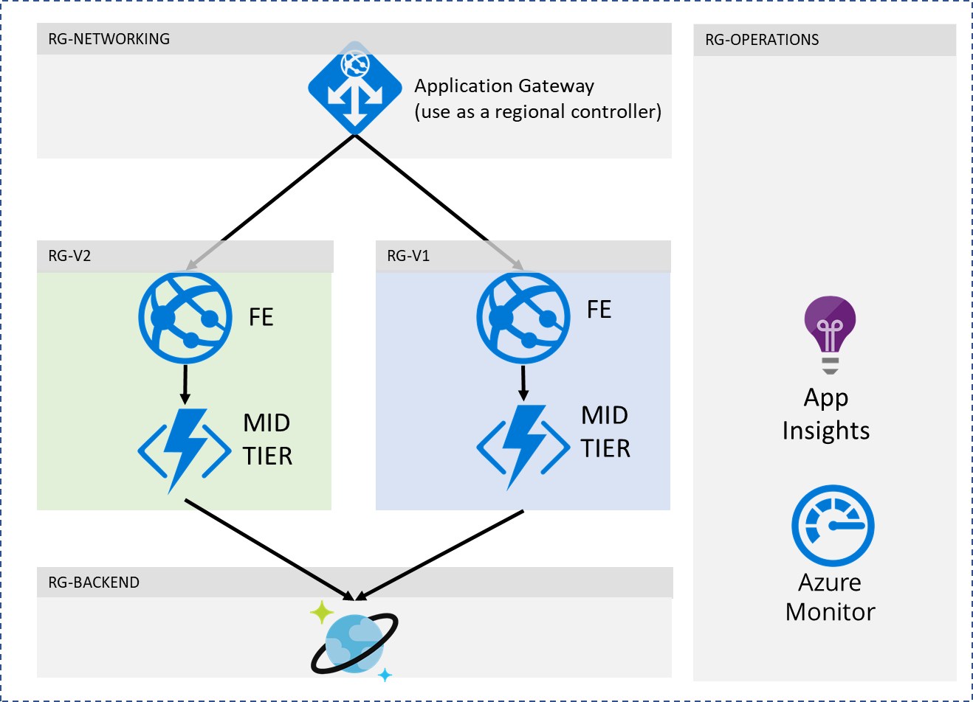
Multi Region Deployment
Traffic Manager
Region 1
Region 2
RG-OPERATIONS
OMS / Log Search
Region 1 or 2

Slide 9
When to switch from v1 to v2 ?
V1 & v2 together
Max exam Duration
v1
v1
v1
v1
v2
v2
v1
v2
v1
v1
v2
v2
v2
v2
v1
v2
v2

Slide 10







Load balancing scenarios
DNS
Traffic
Manager
Load Balancer
Application Gateway / WAF
Load Balancer
DB
DB
DB
DB
DB
DB
DB
DB
REGION A
REGION B
Scalable
Redundant
Scalable
Redundant
+ Protection
+ Global
with multiple
Azure Regions

Slide 11
Appendix

Slide 12
Application Gateway

Slide 13

Application Gateway
OVERVIEW
Level 7 routing
HTTP round robin
Cookie based session affinity
Multi-site hosting
URL based routing
Security
SSL termination
SSL Policy (protocol version and cipher)
End to end SSL
Web Application Firewall
Diagnostics and probes
Rich diagnostics including access and performance logs, WAF logs, backend health log
Custom health probes
fabrikam.com
Application Gateway
Videos
contoso.com
fabrikam.com
Images
contoso.com/video/*
contoso.com/images/*

Slide 14
Enhanced connectivity
HTTPS
Round robin HTTP load distribution
Backend choices
VMs via NICs
Internal IP
External Public IP
VMSS
Azure Web Apps
Containers
Connectivity Options
VMs in same VNet
VMs across connected VNets
Cloud services
Hybrid connectivity to on premises VMs
External servers
VNET 1
Application Gateway
Cloud Service
VM3
VM2
VM1
VNET 2
Cloud Service
On-oremise VM
VM4

Slide 15
SSL management
Whitelist
Backend Pool 1
SSL termination Increased web farm productivity
Central SSL management
User configurable SSL policy
Allow/block SSL protocols
Ciphers and priority
SSL probes
End to end SSL encryption
Secure backend communication
Enable whitelisting
×
HTTPS TLS1.0
Application Gateway
VM1
HTTPS
VM2
HTTPS TLS1.1
×
HTTP
HTTPS sslv3
Backend Pool 2
VM3
VM4

Slide 16
URL routing and multi-site support
fabrikam.com
URL based routing
Backend pool selection based on request path
Configure up to 20 backend pools
Multi site support
Pack up to 20 different domains or subdomains
Each domain to its own backend pool
SSL offload via Server Name Indication (SNI)
Application Gateway
Videos
contoso.com
fabrikam.com
Images
contoso.com/video/*
contoso.com/images/*

Slide 17
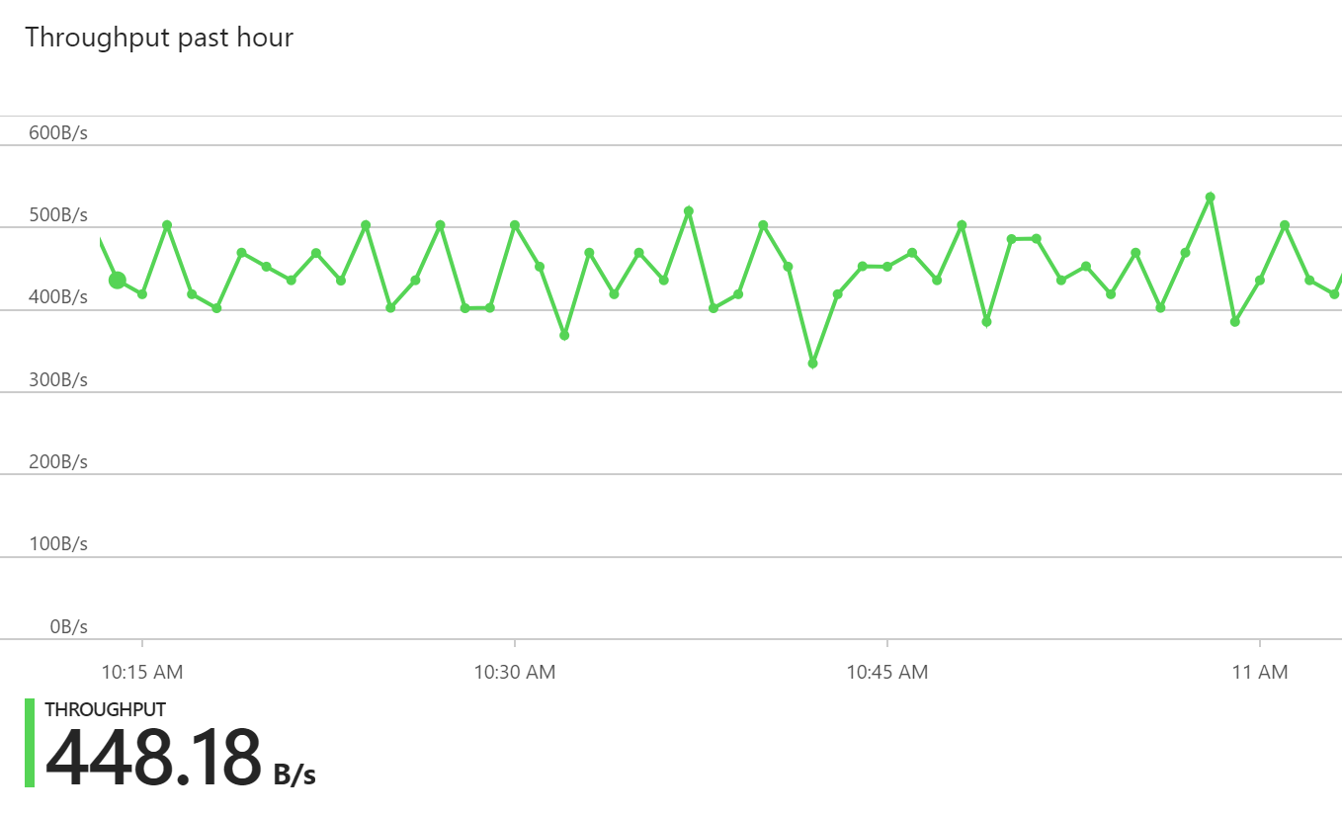
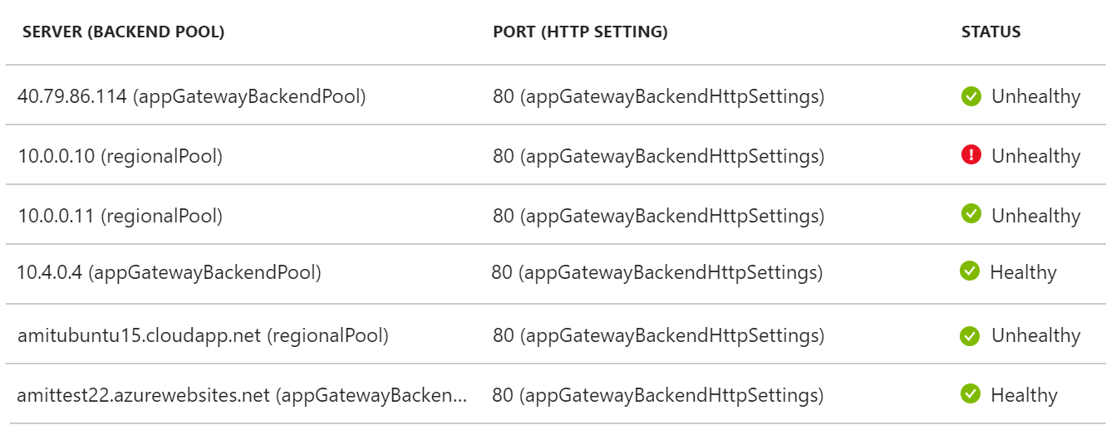
Diagnostics
{
"instanceId":"ApplicationGatewayRole_IN_0",
"clientIP":"37.186.113.170",
"clientPort":"12345",
"httpMethod":"HEAD",
"requestUri":"/xyz/portal",
"requestQuery":"",
"userAgent":"-",
"httpStatus":"200",
"httpVersion":"HTTP/1.0",
"receivedBytes":"27",
"sentBytes":"202",
"timeTaken":"359",
"sslEnabled":"off"
}
Integrated with Azure Monitor
Access logs
Logs each request/response
Log frequency every 5 mins
Performance logs
Logs gateway instance data
Log frequency every 1 min
WAF logs
Metrics data
Alerts
Webjobs
Backend health logs
{
"instanceId":"ApplicationGatewayRole_IN_1",
"healthyHostCount":"4",
"unHealthyHostCount":"0",
"requestCount":"185",
"latency":"0",
"failedRequestCount":"0",
"throughput":"119427"
}

Slide 18
Configurable SSL policy
Control both protocol version and cipher
Harden security at gateway
Compliance
Preconfigured policy
AppGwSslPolicy20170401S
AppGwSslPolicy20170401
AppGwSslPolicy20150501
Custom SSL policy
Specify minProtocolVersion
Specify cipher suites and priority order
SSL policy: preconfigured
Name: AppGwSslPolicy20170401S
MinProtocolVersion: TLSv1_2
CipherSuites:
TLS_ECDHE_ECDSA_WITH_AES_128_GCM_SHA256
TLS_ECDHE_ECDSA_WITH_AES_256_GCM_SHA384
TLS_ECDHE_ECDSA_WITH_AES_128_CBC_SHA
TLS_ECDHE_ECDSA_WITH_AES_256_CBC_SHA
……
……
SSL policy: custom
Name: CustomPolicy1
MinProtocolVersion: TLSv1_0
CipherSuites:
TLS_RSA_WITH_AES_256_GCM_SHA384
TLS_RSA_WITH_AES_128_GCM_SHA256
TLS_RSA_WITH_AES_256_CBC_SHA256
TLS_RSA_WITH_AES_128_CBC_SHA256
TLS_RSA_WITH_AES_256_CBC_SHA
TLS_RSA_WITH_AES_128_CBC_SHA
……
……

Slide 19
Application Gateway redirection
NEW
Redirect HTTP to HTTPS
Backend pool redirection no longer required
Global redirection for whole site
Redirect on a specific site path
Integrated with URL Path Maps
Redirect Listener to listener
.com to .org redirection
One sub domain to another subdomain redirection
Redirect to external site
App Gateway
HTTP
301 redirect
HTTPS

Slide 20
Multi-tenant backend support
NEW
Supports Web App as backend for WAF and Standard AppGw
Supports public facing Web App deployments and App Service Environment (ASE)
Two modes offered to override backend host header
Pick host name from FQDN
User supplied host name
Both SSL offload and end-to-end SSL supported
App Gateway
Host:contoso11
Host:contoso
Host:contoso22

Slide 21
Custom probes enhancements
Custom probes
User defined probes
Probe configured at Backend Settings
Probing done at VM + port granularity
Backend health report for VM health and routing decision
Control probe frequency, timeout, custom URI path, host header
Enhancements
Ability to define HTTP response code range
Ability to inspect response body
service1:80
Backend Pool
Application Gateway
service2:8080
VM1
service2:8080
VM2
service1:8080

Slide 22
Web Application Firewall (WAF)
Site 1
App Gateway
Valid request
Protect applications from web based intrusions
Highly available, scalable, fully platform managed
Built using popular ModSecurity Core Rule Set
CRS 2.2.9
CRS 3.0
Preconfigured rule set for baseline protection from OWASP top 10 vulnerabilities
SQL Injection
XSS attacks
XSS attack
WAF
Site 2
Valid request
Valid request
SQL injection
L7 LB

Slide 23
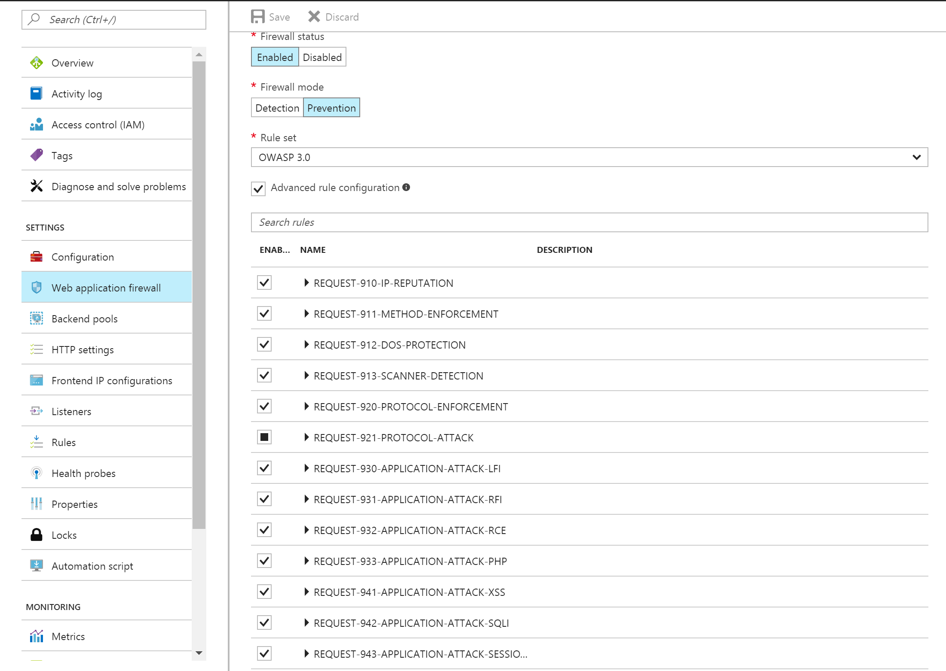
WAF preconfigured rules
RuleSet offered:
CRS 2.2.9
CRS 3.0
Protect from:
SQL Injection
Cross site scripting
Protocol violations
Generic attacks
HTTP rate limiting
Scanner detection
Session fixation
LFI/RFI

Slide 24
WAF user configurable rules
Rule configurability
Prevention/Detection modes
Change RuleSet CRS 2.2.9 or CRS 3.0
Enable or Disable entire RuleGroups
Enable or Disable individual rules to eliminate false positives
RuleSet
Rule group
Rule
XSS
Rule 1
CRS 2.2.9
SQL I
Rule 2
….
….
….
….
CRS 3.0
WAF
LFI
LFI
Rule n

Slide 25
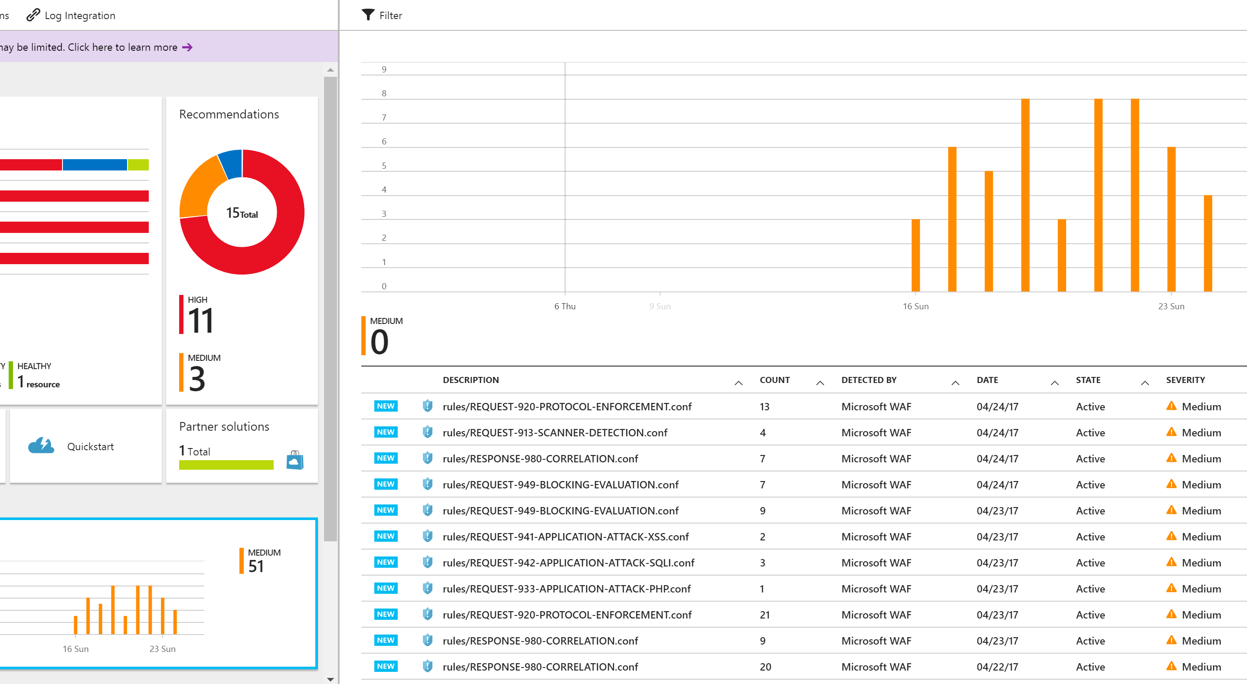
Monitor intrusions
Event Hub
Enable WAF log via Azure Monitor
Real time logs to monitor attacks
WAF logs integrated with:
Customer storage account in JSON format
Event Hub
OMS Log Analytics enabling search
Azure Security Center Integration
WAF
Azure Storage
Azure Monitor
OMS Log Analytics
REST API
WAF log
Third party
tools

Slide 26
Load balancing scenarios
DNS
Traffic
Manager
Load Balancer
Application Gateway / WAF
Load Balancer
DB
DB
DB
DB
DB
DB
DB
DB
REGION A
REGION B
Scalable
Redundant
Scalable
Redundant
+ Protection
+ Global
with multiple
Azure Regions

Slide 27

Traffic Manager

Slide 28

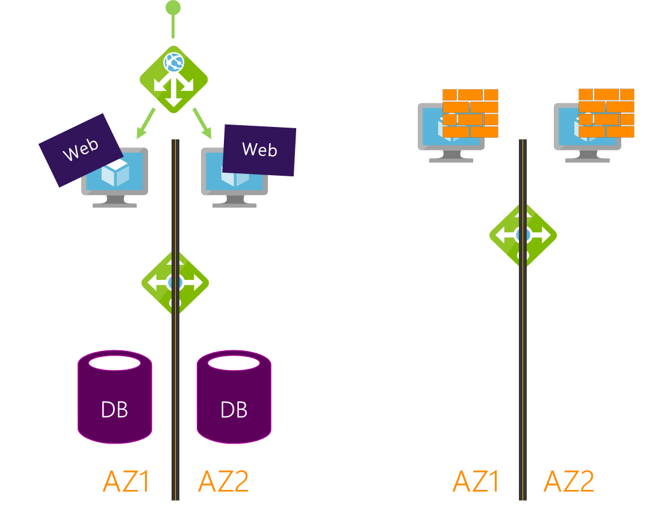
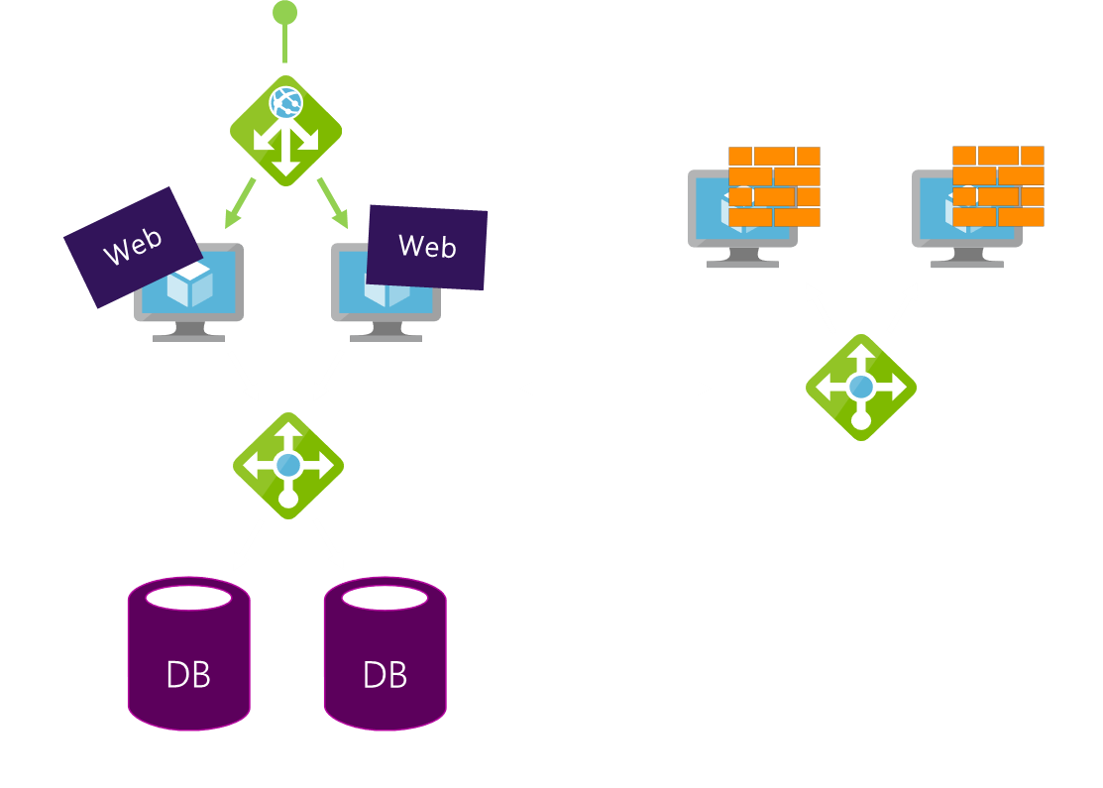
Global Resiliency & Performance with DNS
Easy Onboarding
Multiple Routing Methods
Endpoint monitoring
High resiliency
?
Traffic Manager

Slide 29

Traffic Manager Routing Methods
Priority
Traffic Manager
Priority 1
Priority 2
Priority 3

Slide 30
Traffic Manager Routing Methods
Priority
Traffic Manager
Weighted Round Robin
Central US
1%
West US
49%
East US
50%

Slide 31
Traffic Manager Routing Methods
Priority
Weighted Round Robin
Geographic

Slide 32
Traffic Manager Routing Methods
Priority
Weighted Round Robin
Geographic
Performance

Slide 33

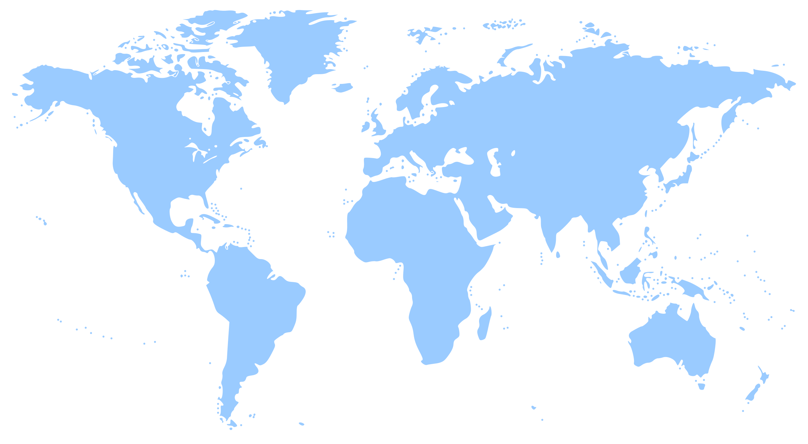



Traffic Manager Real User Measurements
Increased accuracy in routing decisions by leveraging Real User Measurements (RUM) taken from where your end users connect from
Latency metrics are obtained from your customer base ensuring that all end users networks relevant to you are covered
Integration with Visual Studio Mobile Center
NEW

Slide 34
Traffic Manager Routing Methods
Priority
Parent Profile - Performance
Weighted Round Robin
Geographic
Child Profile – Weighted RR
Performance
East Asia
East US
West Europe
Nested
5%
95%
West Europe 1
West Europe 2

Slide 35
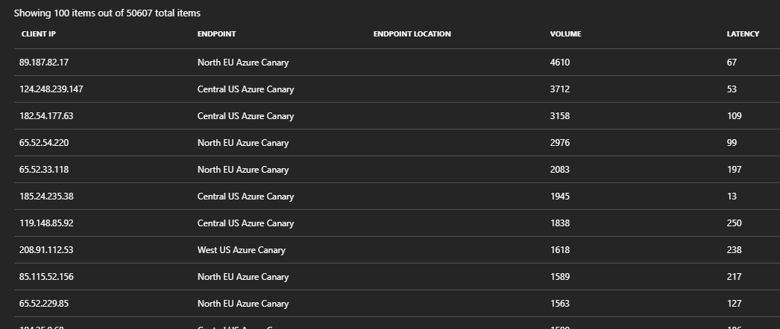
Traffic Manager—Traffic View
Understand the volume of traffic generated by your users and the latency experienced by them, at a per region level
Deep dive into traffic flow patterns from a specific region
NEW

